Slide 1


The relationship between big data and cloud computing
Created By Tyler S. Unsworth
Contact Information Tyler.Unsworth@cwu.edu

Slide 2

Content to be discussed
Explore the history
The advantages and disadvantages
The characteristics of big data
Fields where implementation of cloud computing can be beneficial such as
Notes:
Earth Science
Mobile Devices
Big Data Processing
Healthcare

Slide 3
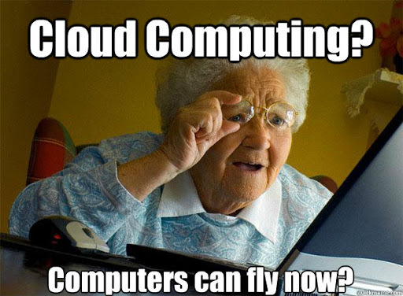
NO!

Slide 4
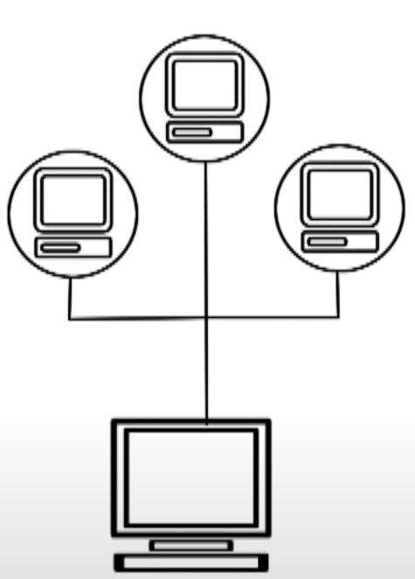
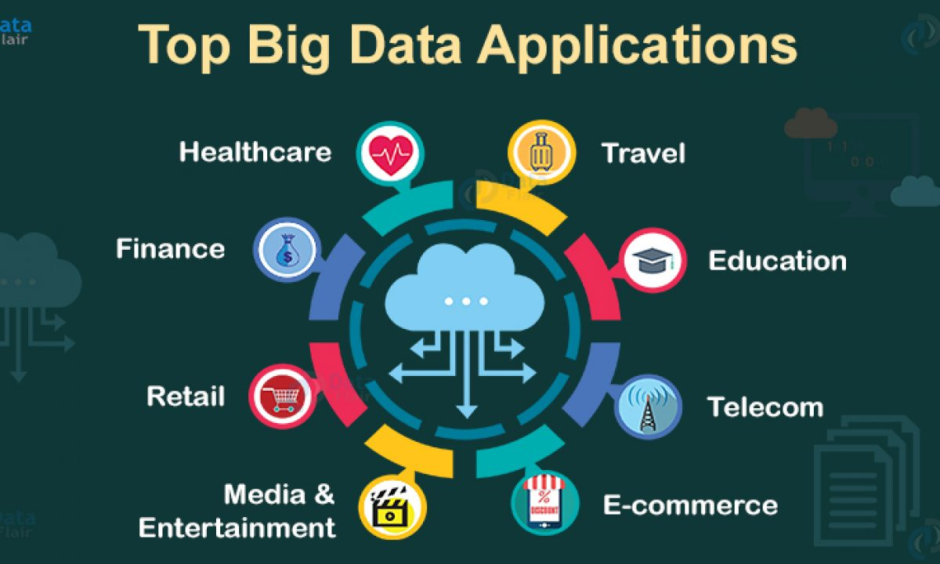
The History between
Cloud Computing
Big Data
The etymology of cloud computing traces back to overlapping server icons (like the image below)
Provides its users with fast access to their data
It also helps in running complex computing
Data that can be processed to reveal patterns, trends, and associations.
Big data is produced by all the data applications below
Structured
Unstructured
Semi Structured
Notes:
** Big Data **
The first evidence of big data in our society was found approximately seven thousand years ago in Mesopotamia through evidence of accounting.
Produced by applications such as:
- Healthcare, E-commerce, telecommunication and so much more.

Slide 5
The Advantages and Drawbacks of Using Cloud computing
Advantages
Drawbacks
Affordable
Easy to Upgrade
No IT maintenance costs
Virtualization
Gives Historically Underprivileged Countries A Start
Ability To Perform Large Scale Complex Computing
Network Dependency
Increased spending on high-speed internet
Vulnerability To Attacks
Limited Features Without Premium Package
Physical Location And Software Update Schedules Are Unknown
Inability to conduct in house support
Notes:
Virtualization which is the creation of virtual servers, infrastructures, devices and computing resources. It is what helps cloud computing to run as efficiently as it does.

Slide 6
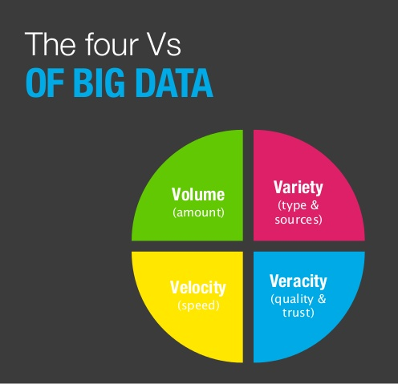
The Scope of Big data
Big data has four defined characteristics:
Variety
Volume
Velocity
Veracity
Fun FACT:
The estimated volume of data alone in 2017 was estimated to be around 2.7 trillion gigabytes
As of today, nearly every two days we creates much information as we did from the beginning of time until 2003!
Notes:
Variety – Denotes the different types of data
Volume – Denotes the size of the data
Velocity – Denotes the speed at which data is generated
Veracity – Is the trustworthiness

Slide 7


Applicable Fields For Cloud Computing
Cloud computing in this field would:
Save rental fees for the use of supercomputers at other universities and labradorites
Saves time without having to learn each supercomputer’s functionality and software
Power costs from running computationally expensive simulations
Findings By
Running micro benches to test hardware components
Cloud Computing aids fields like healthcare by
More sophisticated treatments
Supply Chain Maintenance
Patients History anywhere in the world
Research Work
Integrating cloud computing in mobile devices:
Overcome limited storage capacity
Increased CPU power
Drastically increased battery life
Cloud Computing
Earth Science
Mobile Devices
Big Data Processing
Healthcare
Cloud Computing Helps Big Data by
Low-Cost Resource Utilization
Reduces The Need For Physical Storage Devices
Increases value of a company while reducing costs

Slide 8
Conclusion
Now more than ever, big data is being created everywhere
Revolutionize
Google
Snapchat
Twitter
Earth Science
Mobile Devices
Big Data Processing
Healthcare
Notes:
So the answer to my research question is yes, cloud computing should be more common place and can prove to aid a variety of different fields both discussed and not.

Slide 9


References
Bakhouya, M., Zbakh, M., Essaaidi, M., & Manneback, P. (2020). Cloud computing, IoT, and big data: Technologies and applications. Concurrency and Computation Practice and Experience, 32
Buyya, R., Srirama, S. N., Casale, G., Calheiros, R., Simmhan, Y., Varghese, B., Gelenbe, E., Javadi, B., Vaquero, L. M., & Netto, M. A. S. (2017). A Manifesto for Future Generation Cloud Computing: Research Directions for the Next Decade. ACM Computing Surveys, 51
Coro, G., Panichi, G., Scarponi, P., & Pagano, P. (2017). Cloud computing in a distributed e-infrastructure using the web processing service standard. Concurrency and Computation Practice and Experience, 29
Chang, V., Kuo, Y.-H., & Ramachandran, M. (2016). Cloud computing adoption framework: A security framework for business clouds. Future Generation Computer Systems, 57, 24–41
Hashem, I. A., Yaqoob, I., Anuar, N. B., Mokhtar, S., Gani, A., & Khan, S. U. (2015). The rise of “big data” on cloud computing: Review and open research issues. Information Systems, 47, 98–115
Saif, S. & Wazir, S. (2018). Performance Analysis of Big Data and Cloud Computing Techniques: A Survey. Procedia Computer Science, 132
Tawalbeh, L., Mehmood, R., Benkhlifa, E., & Song, H. (2016). Mobile Cloud Computing Model and Big Data Analysis for Healthcare Applications. IEEE Access, 4, 6171–6180
Villalpando, L. E. B., April, A., & Abran, A. (2014). Performance analysis model for big data applications in cloud computing. Journal of Cloud Computing, 3
Zhuang, J., Jacob, D. J., Lin, H., Lundgren, E. W., Yantosca, R. M., Gaya, J. F., & Sulprizio, M. P. (2020). Enabling High-Performance Cloud Computing for Earth Science Modeling on Over a Thousand Cores: Application to the GEOS-Chem Atmospheric ChemistryModel. James Journal of Advances in Modeling Earth Systems, 12
Zhou, Z. & Zhao, L. (2020). Cloud computing model for big data processing and performance optimization of multimedia communication. Cloud Communications, 160, 326–332
Notes:
A list of my 10 references…..
Make sure to greet ☺
Thank you for your time.

